Slide 1

RUMOUR
PROPAGATION
THROUGH
GRAPH THEORY
Tracing Whispers
Investigating Rumour Spread Dynamics via Graph Theory Analysis
Dt - 12ᵗʰ April 2024
Group - 4
Guided by : Ekta Saraf
Presented by : 2202040013 - Animesh Pattnaik
2202040014 - Chirag Agrawal
2202040015 - G. Tejesh Kumar
2202040016 - Subham Kumar Sahoo

Slide 2
INTRODUCTION
Welcome to our presentation on understanding rumour spreading through the lens of graph theory.
Rumours have been a part of human communication since time immemorial, shaping opinions, behaviours, and even societies.
In today's digital age, where information travels at lightning speed through interconnected networks, understanding how rumours propagate is more crucial than ever.
Graph theory provides a powerful framework for studying the dynamics of rumour spreading, offering insights into how information flows through social, communication, and biological networks.
Join us as we delve into the fascinating world of rumour spreading, exploring the key concepts, models, and implications from a network perspective.

Slide 3
FUNDAMENTAL OF RUMOUR SPREADING MODEL
A rumour spreading model in graph theory typically involves a network of nodes where rumours, information, or influences propagate through connections between nodes. One common model is the susceptible-infected model, where nodes are either susceptible to the rumour or infected by it.
Essential Elements of Rumour Spreading Model
Nodes : Represents individuals in the network
Edges : Represents connection between nodes
States : Nodes can be in one of two states i.e. susceptible or infected
Propagation : Rumours spread from infected nodes to susceptible neighbours through edges
Dynamics : Infected nodes remain infected indefinitely, and susceptible nodes become infected upon contact with infected nodes

Slide 4
Key Concepts Utilised in Rumour Spreading Models
Breadth-first Search (BFS): It is a graph traversal algorithm that systematically explores neighbour nodes at each level before moving to deeper levels.The main characteristics of BFS include its simplicity, efficiency in finding the shortest path in an unweighted graph, and its ability to discover the shortest path from the source node to any other node.
Reverse Minimum Spanning Tree : Reverse Minimum Spanning Tree (Reverse MST) is an approach that involves removing edges from a given graph to construct a tree that maximises the total weight of the removed edges while maintaining connectivity. Unlike traditional Minimum Spanning Trees (MSTs), Reverse MST prioritises edges with the highest weights, aiming to maximise rather than minimise the total weight of the removed edges. Reverse MST finds applications in scenarios such as network design, resource allocation, and optimisation problems where maximising the overall weight of selected edges is desirable.

Slide 5
Key Concepts Utilised in Rumour Spreading Models
3. Custom Colour Coding : Custom colour coding involves assigning specific colours to elements in a visual representation according to predetermined criteria. This method enhances visualisation, aids in understanding complex data, and facilitates quick interpretation. Custom colour coding finds applications in data analysis, visualisation, and presentation, offering tailored solutions for effective communication and decision-making.
4. Set Logic : Set logic is a fundamental tool in graph theory, offering a systematic approach to analyse the structure and relationships within graphs. In graph theory, sets play a crucial role in representing vertices, edges, and various subsets of these elements. Set operations such as union, intersection, difference, and complementation are applied to these sets to extract meaningful information about the graph.

Slide 6

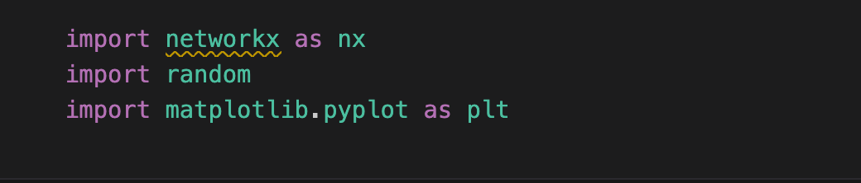
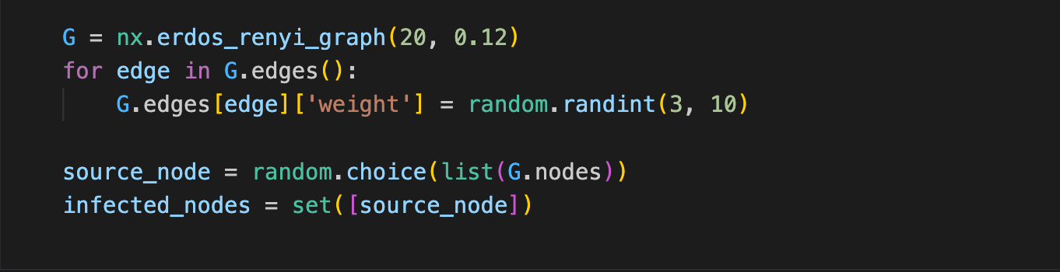
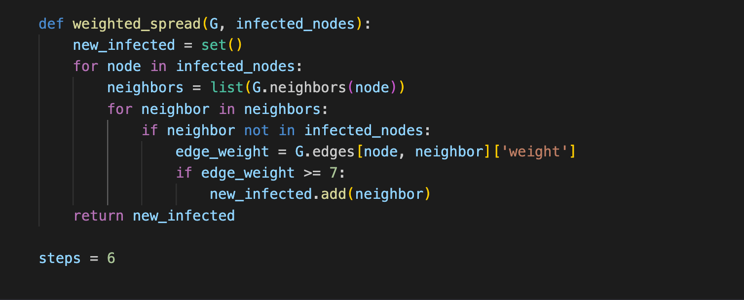
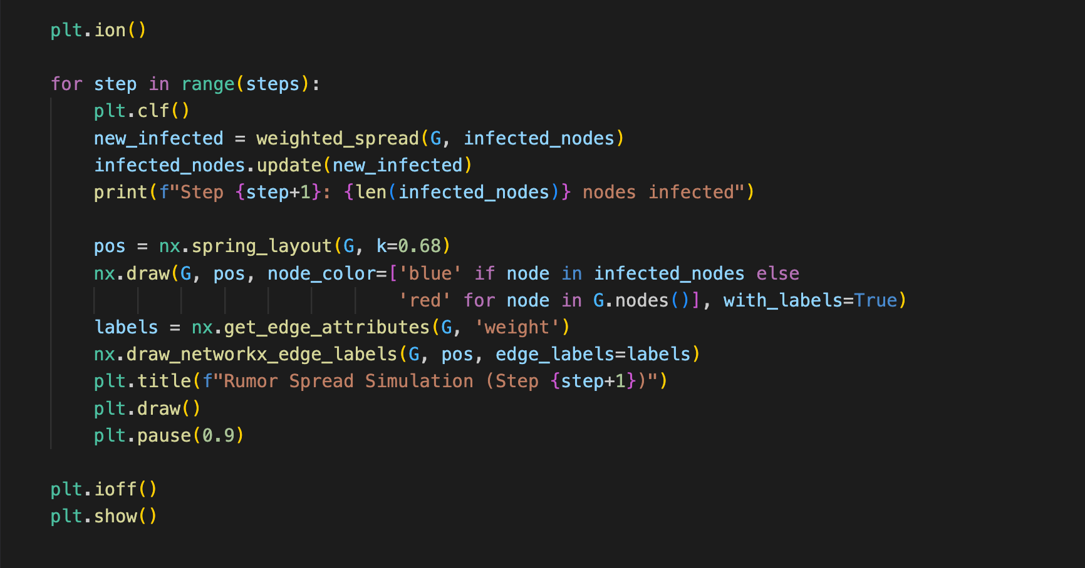
Importing required libraries
Making the graph and giving edge
weight and creating infected node
Applying BFS and if the edge weight
is greater than 7 then adding it to the
infected nodes
Plotting and Running the Graph

Slide 7
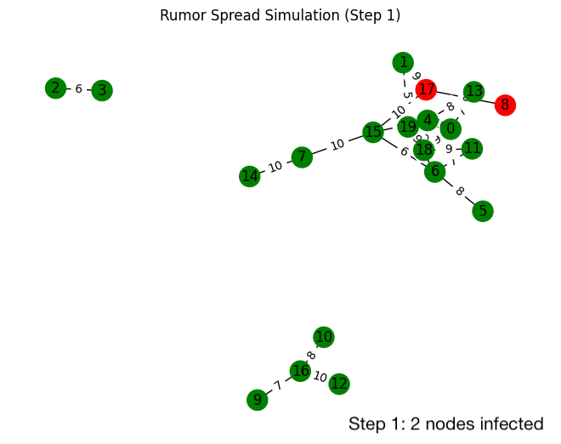

Slide 8
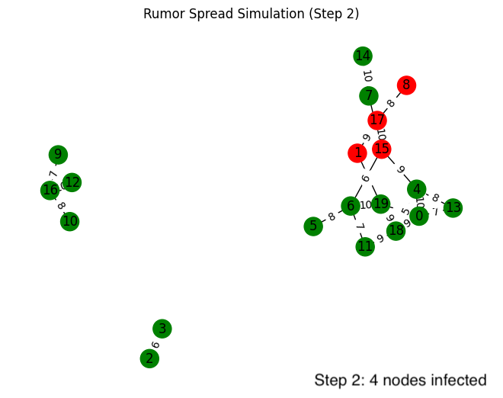

Slide 9
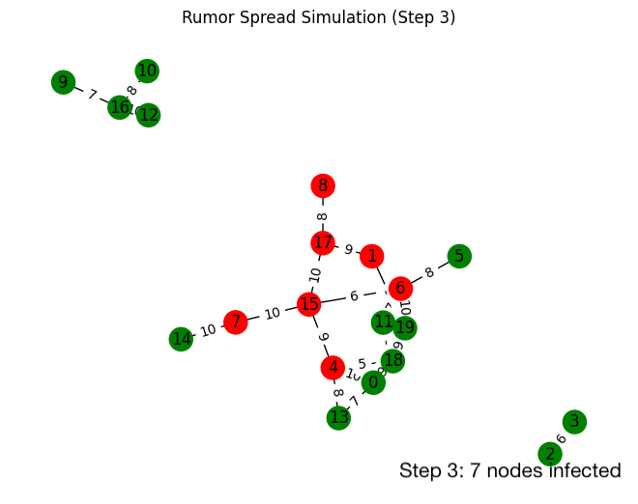

Slide 10
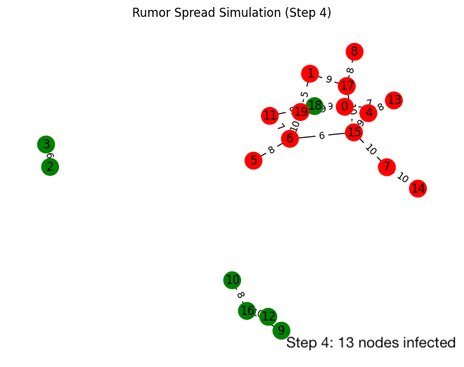

Slide 11
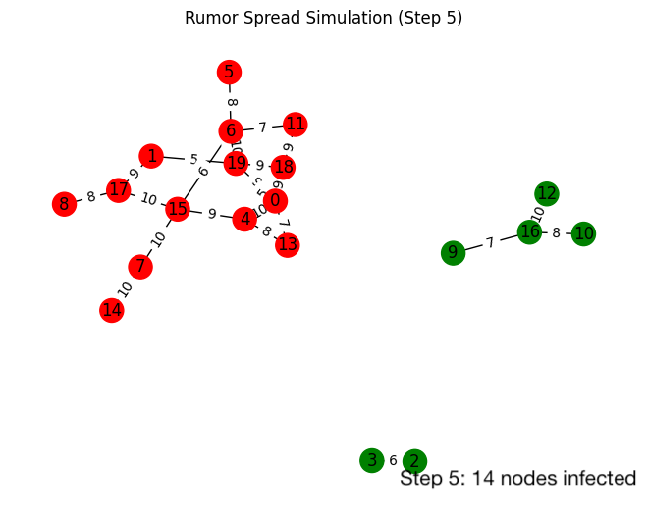

Slide 12
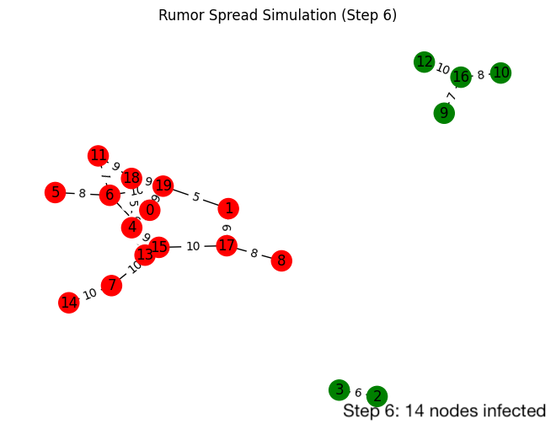

Slide 13
CONCLUSION
Key insights : Graph theory provides a robust framework for modelling and analysing rumour spreading dynamics, offering insights into how information propagates through interconnected networks.
Understanding Dynamics : By studying susceptible-infected model, we gain valuable insights into the spread, containment, and recovery of rumours in various network topologies.
Implications : Understanding rumour spreading through graph theory has implications in diverse fields, including social media analysis, epidemiology, marketing strategies, and crisis communication.
Mitigation Strategies : Insights from rumour spreading models can inform the development of effective strategies for rumour control, misinformation detection, and crisis management in online and offline communities.
Future Directions : Continued research in rumour spreading models using graph theory will lead to advancements in understanding complex social dynamics, enhancing network resilience, and mitigating the impact of misinformation in the digital age.

Slide 14
THANK YOU

